Slide 1
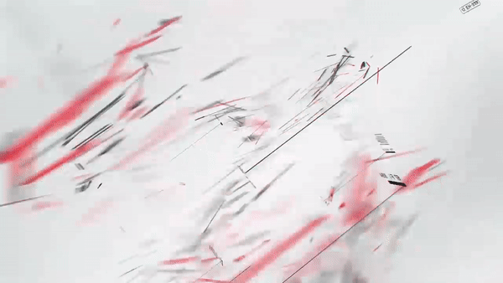

Slide 2

Welcome To
2
Research Center Digital Business Ecosystem

Slide 3
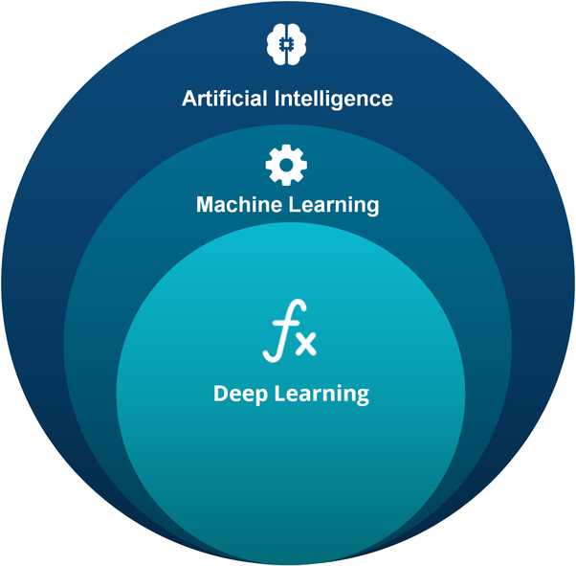
3
Artificial Intelligence Machine Learning Deep Learning
Research Center Digital Business Ecosystem

Slide 4
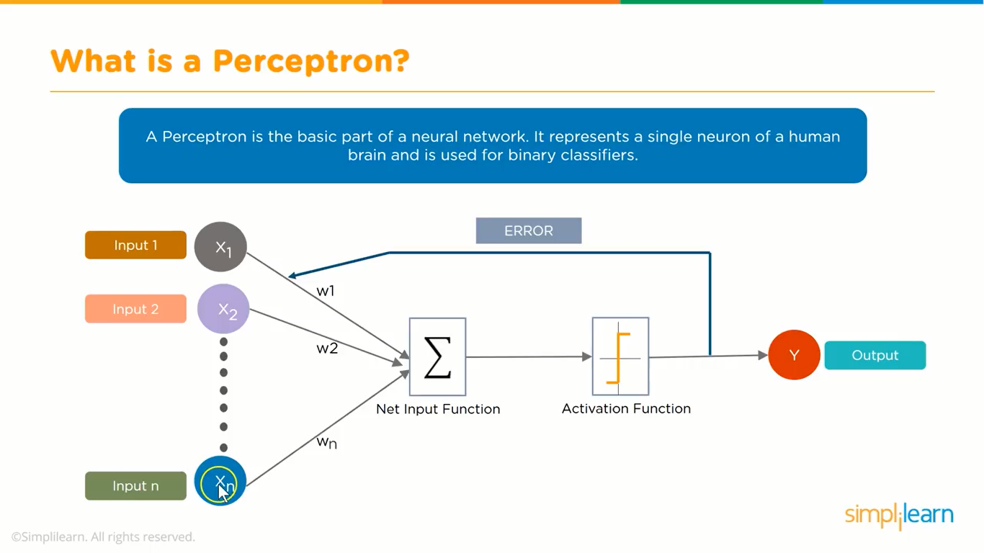
4
Component Of Artificial Neural Networks
Net input = x₁.w₁ + x₂.w₂ + x₃.w₃ = ∑x_{i}.w_{i}
Or using simple matrix multiplication
[w1 w2 w3] [x1 x2 x3] = x₁.w₁ + x₂.w₂ + x₃.w₃
- Input - Weight - Bias - Activation Function
Research Center Digital Business Ecosystem

Slide 5
How It Work Perceptron
5
- Perceptron is the basic part of a neural network, which represents a single neuron
- A neuron is a computational unit that calculates a piece of information based on weighted input parameters
- Inputs accepted by the neuron are separately weighted.
- Weights are real numbers expressing the importance of the respective inputs to the output and can be adjusted during learning phase
y = (x₀w₀) + (x₁w₁) + (x₂w₂)
= ∑_{i}x_{i} w_{i}
= [w₀ w₁ w₂] [ x₀ ]
x₁
x₂
Research Center Digital Business Ecosystem

Slide 6
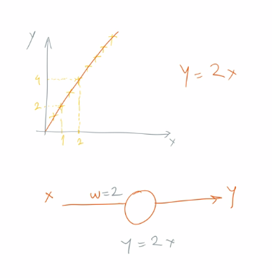
How It Work Bias
6
- A bias value allows you to shift the activation function to the left or right, which may be critical for successful learning.
- Changes in weight change the steepness of the curve, while bias shifts the entire curve so that it is more suitable.
- Bias only affects the output value, it does not interact with the actual input data
- Bias value can be adjusted during learning phase
y = ∑_{i}x_{i}w_{i} + b
Research Center Digital Business Ecosystem

Slide 7
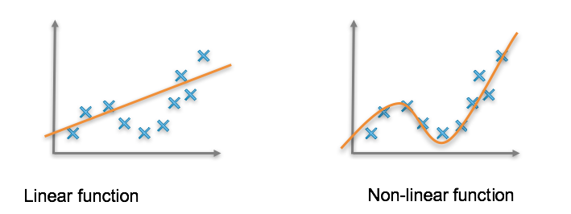
7
Activation Functions
Decides whether a neuron should be activated or not by calculating weighted sum and adding bias with it.
Introduce non-linearity into the output of a neuron → making it capable to learn and perform more complex tasks
If we do not use activation function, the output signal produced is only a linear function
Research Center Digital Business Ecosystem

Slide 8
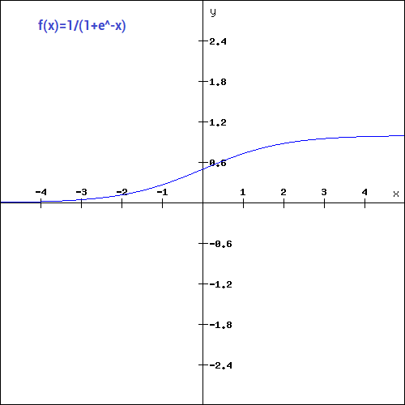
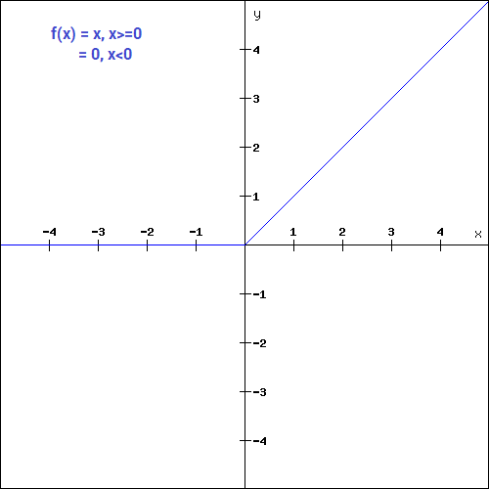
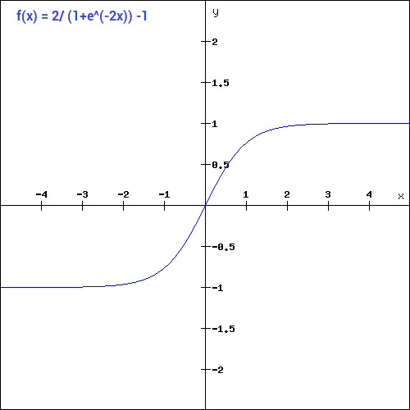
8
Activation Functions
y = f(∑_{i}x_{i}w_{i} + b)
Sigmoid function
ReLu function
Commonly used activation functions:
- Sigmoid function :
- Tanh function :
- ReLU (Rectified Linear Unit) : A(x) = max(0,x)
- Softmax function : converts an array of values into an array of probabilities (0 - 1)
tanh function
www.yourwebsite.com
Research Center Digital Business Ecosystem

Slide 9

Learning Rule 2 Steps of Learning
9
Forward propagation
weights and bias are initialised randomly
calculate forward (from input layer to output layer) to get the output
compare it with the real value to get the error → using lost function or cost function
Backward propagation
propagate backwards and do:
finding the derivative of the lost function with respect to each weight
update the weight by subtracting this value from the weight value.
Research Center Digital Business Ecosystem

Slide 10

Loss Function and Gradient Descent
10
1
Loss function : a method of evaluating how well your algorithm models your dataset.
2
Learning = minimizing loss function
How = change the weights* by calculating the gradient (i.e. the partial derivative of loss function with respect to weights)
3
Since we want the value to be minimum → gradient descent. This is the simplest and most popular optimization method for deep neural network
4
5
Other methods : Newton's method, Conjugate Gradient, Quasi-Newton, Levenberg-Marquardt algorithm.
Research Center Digital Business Ecosystem

Slide 11
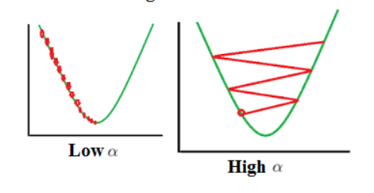

Learning Rate
11
the effects of different learning rates
The gradient told us the direction to change the weight.
How much we must change is determined by another hyperparameter called learning rate or α
Picking the value of α is crucial
too small → training process too slow
too big → diverging away from the minimum / overshoot
We can pick α manually or using optimization technique that utilize adaptive learning rate (e.g. Adagrad, RMSProp, Adam)
For example:
w’ = w - α (∂E/∂w) → α is learning rate
Research Center Digital Business Ecosystem

Slide 12
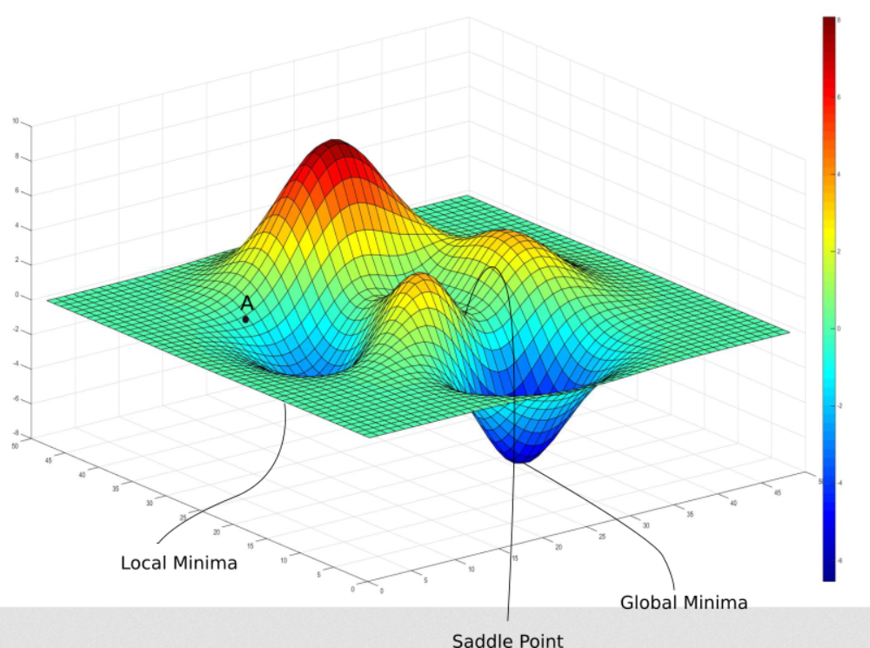
Gradient Descent Implementation
1
When we should update the weight? → there are 3 types of gradient descent implementation
Stochastic Gradient Descent : randomized the data, and update the weights for each training instance.
Batch Gradient Descent : process all training dataset in a single batch, calculate the error and update the weight accordingly.
Minibatch Gradient Descent : splits the training dataset into small batches, calculate error and update weights for each small batches.
Challenges in Gradient Descent
Research Center Digital Business Ecosystem

Slide 13
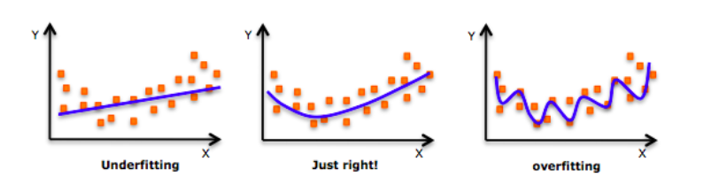
2
1
The complicated nature of deep neural network makes it prone to overfitting.
A model is overfit if it performs well on training data but not generalize well on new unseen data
Regularization is any modification we make to the learning algorithm that is intended to reduce the generalization error, but not its training error (Ian Goodfellow)
The purpose is to control model complexity and reduce overfitting
2
3
4
Overfitting and Regularization
Research Center Digital Business Ecosystem

Slide 14
Most Common Regularization Technique
2
Weight penalty L2 & L1
Loss = Loss + Regularization
L2 → Loss = Loss + α ∑w2
L1 → Loss = Loss + α ∑w
1
Dropout
At each training iteration a dropout layer randomly removes some nodes in the network along with all of their incoming and outgoing connections.
2
Early stopping
Interrupting the training procedure once model’s performance on a validation set gets worse
3
4
Dataset augmentation
Use bigger dataset by using synthetic data
Research Center Digital Business Ecosystem

Slide 15
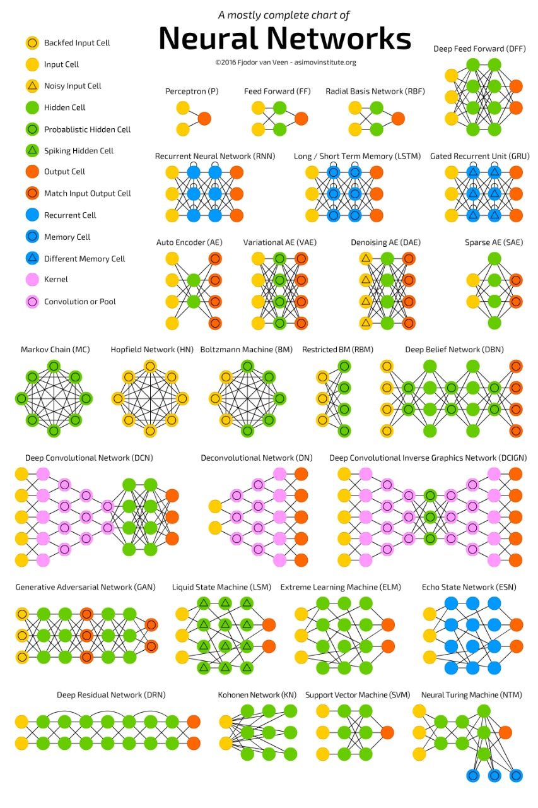
https://becominghuman.ai/cheat-sheets-for-ai-neural-networks-machine-learning-deep-learning-big-data-678c51b4b463
2
Neural Network Chart
Research Center Digital Business Ecosystem

Slide 16

Deep Learning vs Classical Machine Learning
2
1
In classical machine learning, most of the features used require identification of domain experts
Deep networks scale much better with more data than classical ML algorithms
2
Deep learning techniques can be adapted to different domains and applications far more easily than classical ML
3
Research Center Digital Business Ecosystem

Slide 17
Why Now?
2
?
1
Exponential data growth (and the ability to Process Structured & Unstructured data)
2
Faster & open distributed systems (Hadoop, Spark, TensorFlow, …)
3
Faster machines and multicore CPU/GPUs
4
New and better models, algorithms, ideas:
Better, more flexible learning of intermediate representations
Effective end-to-end joint system learning
Effective learning methods for using contexts and transferring between tasks
"The analogy to deep learning is that the rocket engine is the deep learning models and the fuel is the huge amounts of data we can feed to these algorithms." - Andrew Ng
Research Center Digital Business Ecosystem

Slide 18
What is Deep Learning ?
2
?
1
Machine learning algorithms based on learning multiple levels (i.e deep) of representation/ abstraction (1)
2
Learning algorithms derive meaning out of data by using a hierarchy of multiple layers of units (neurons)
Each neuron/node computes a weighted sum of its inputs and the weighted sum is passed through a nonlinear function, each layer transforms input data in more and more abstract representations
3
4
Learning = find optimal weights from data
Research Center Digital Business Ecosystem

Slide 19
Why Deep Learning
2
?
1
Manually designed features are often over-specified, incomplete and difficult to design and validate. Learned Features are easy to adapt, fast to learn
2
Deep learning provides a very flexible, (almost?) universal, learnable framework for representing world, visual and linguistic information.
3
Insufficiently deep architectures can be exponentially inefficient
4
Distributed representations are necessary to achieve non-local generalization
Research Center Digital Business Ecosystem

Slide 20
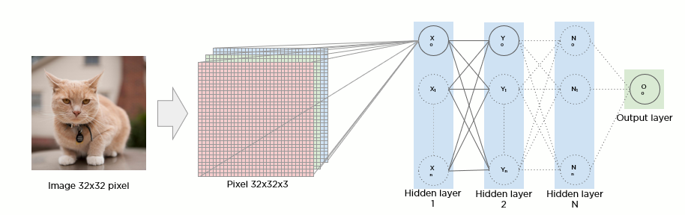
2
Image Processing in ANN
Regular Neural Nets don’t scale well to full images
E.g : CIFAR-10 images size 32x32x3 (32x32, 3 color channels - RGB) → 32*32*3 = 3072 weights in a single neuron in a first hidden layer
For 200x200x3 image → 200*200*3 = 120,000 weights
Parameters would add up quickly → quickly lead to overfitting.
In order to reduce the number of parameters, it is used by using the convolution method
Research Center Digital Business Ecosystem

Slide 21
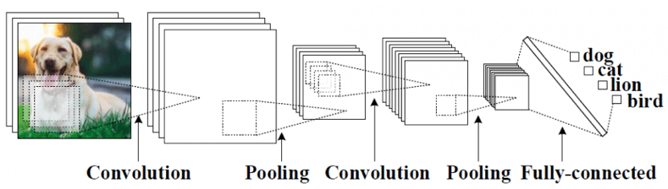
2
Convolutional Neural Network Overview
A Convolutional Neural Network (CNN) is comprised of one or more convolutional layers (often with a subsampling step) and then followed by one or more fully connected layers as in a standard multilayer neural network.
in 1998, Convolutional Neural Networks were introduced in a paper by Bengio, Le Cun, Bottou and Haffner.
Their first Convolutional Neural Network was called LeNet-5 and was able to classify digits from hand-written numbers.
Research Center Digital Business Ecosystem

Slide 22
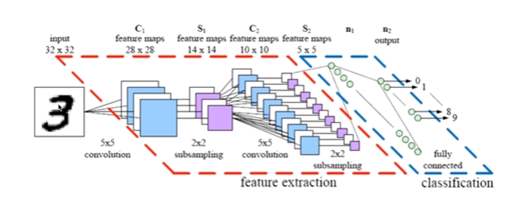
2
CNN Layers
The common types of layers in CNN architecture : Convolution - Pooling - Fully Connected
Convolution layer is the core that does most of the computation
Pooling layer performs dimensionality reduction and controls overfitting. Commonly puts between the convolution layers. The Convolution and Pooling layer acts as feature extraction part
Fully Connected layer generally ends the CNN. It acts as classification part
Research Center Digital Business Ecosystem

Slide 23
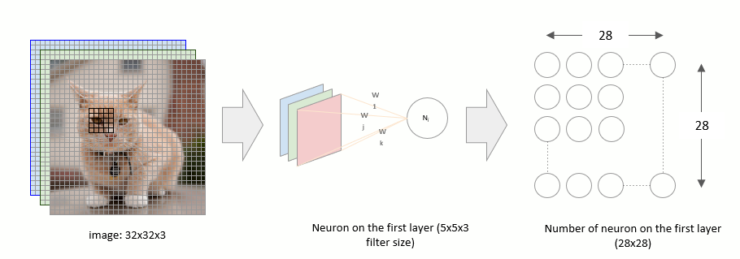
2
Convolution Layer
The first layer of CNN is always convolution layer
Convolution layer consist of a set of learnable filters (also called kernel, or weight)
Filter is a small array of number, and covers all the input depth.
For the CIFAR-10 data, we may have a 5x5x3 filter (5x5 matrix for 3 color channels)
Each neuron will have weights to a [5x5x3] region in the input volume → 5*5*3 = 75 weights → this is what we will learn
The filter will convolve around the image, performing dot product operation between the filter and the part of the image it convolves with
Research Center Digital Business Ecosystem

Slide 24
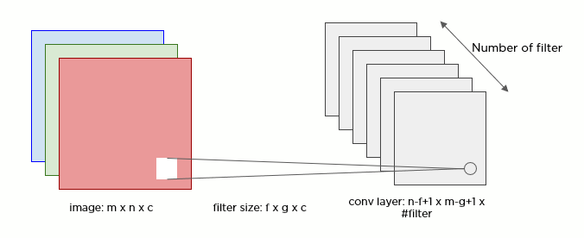
2
Convolution Layer
Hyperparameter
There are 3 hyperparameters to set in the conv layer: number of filter, stride, and padding
Filter size
Number of filter
Stride
Padding
Research Center Digital Business Ecosystem

Slide 25
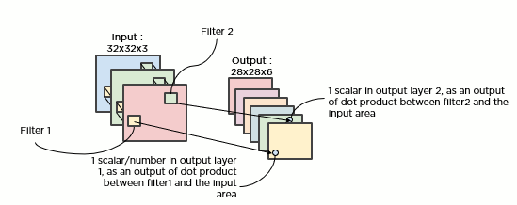
2
Number of Filters
The number of filters called depth column (or fibre) → note that it’s different from input depth.
We may have multiple filter for a conv layer, each layer learns different features (e.g. straight edges, blobs of color, curves, etc.)
The 3rd dimension of output layer of a conv layer = the number of filters
If we use 6 filters of 5x5x3 for our example, the output will be 28x28x6 (6 layers of 28x28)
Research Center Digital Business Ecosystem

Slide 26

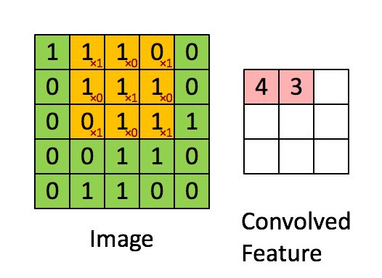
2
Stride
Stride = how much we shift the filter at a time. The bigger the stride, the smaller the output.
Formula to calculate output width and height = (W−F)/S+1, where W = input size (width or height), F = filter size (width or height), and S = stride
Stride is normally set in a way so that the output volume is an integer and not a fraction.
For stride = 3, the output will be (32-5)/3+1 = 10x10
Example for 7x7 input with 3x3 filter :
Research Center Digital Business Ecosystem

Slide 27
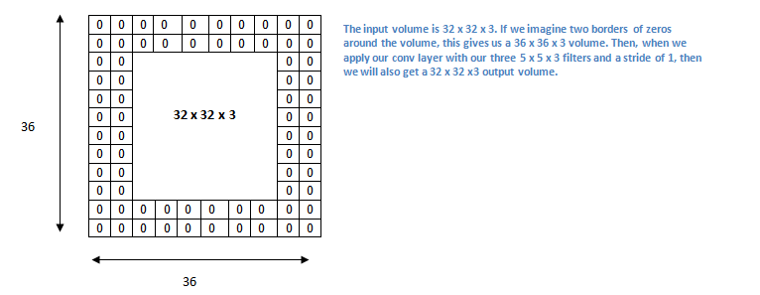
2
Padding
Used to preserve the size of the output.
The formula : (W − F + 2P ) / S + 1, where P = padding
If we want to preserve the output spatial size to 32x32 with our 5x5 filter, we can use padding=2 and stride=1, so output = (32 - 5 + 4) + 1 = 32
Research Center Digital Business Ecosystem

Slide 28

2
Pooling Layer
Also called down sampling layer.
Reduce the spatial size to reduce the amount of parameters and computation, and to control overfitting.
It operates independently on every layer/ depth slice of the input → output depth = input depth
The most common is : 2x2 with stride = 2. Other common setting is F=3x3 ,S=2 (overlapping pooling).
Most common operation = max pooling. Other less common operation = average pooling
Research Center Digital Business Ecosystem

Slide 29
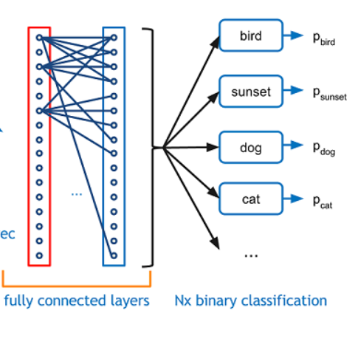
2
Fully Connected Layer
Neurons in a fully connected layer have connections to all activations in the previous layer, as seen in regular neural networks.
Usually put at the end of the CNN architecture to perform the classification.
FF layer outputs an N dimensional vector where N is the number of classes that the program has to choose from.
Many newer CNN architectures doesn’t use Pooling and/or Fully Connected Layer
Research Center Digital Business Ecosystem

Slide 30
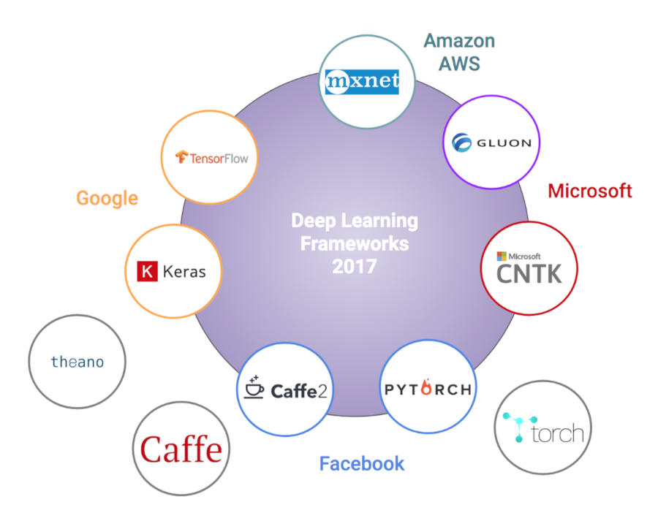
1
Deep Learning Library
www.yourwebsite.com
Research Center Digital Business Ecosystem

Slide 31
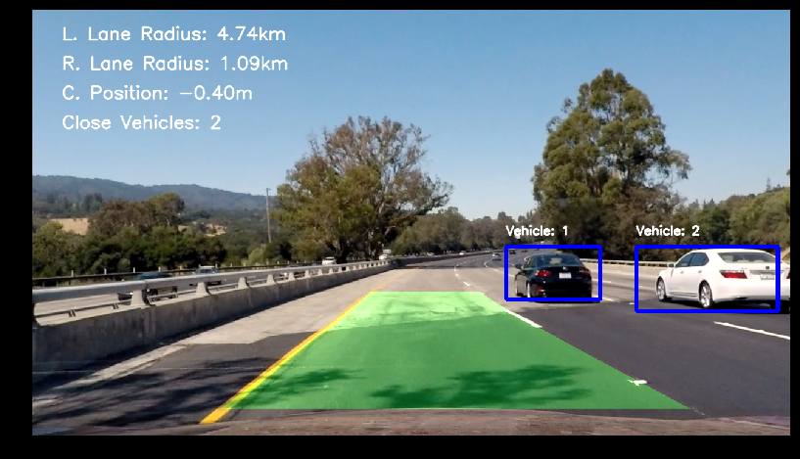
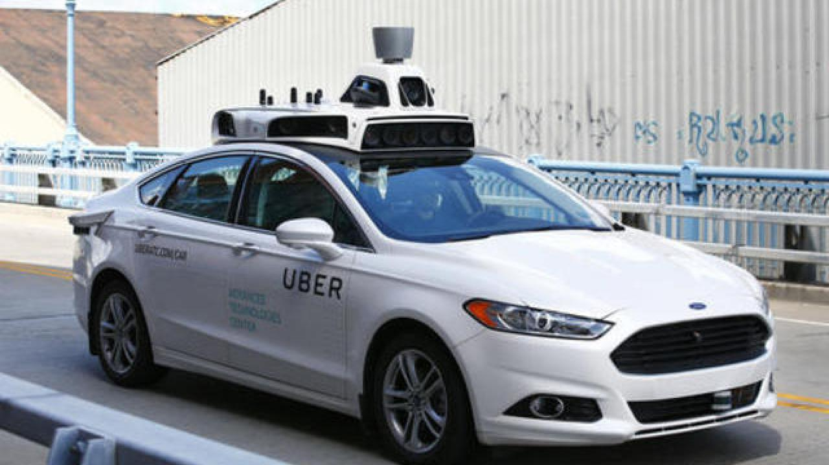
Use Case Self-Driving Cars
2
01
Uber first announced its intentions to amass a fleet of automatic cars in February 2015
02
The cars themselves were packed with around 20 cameras, seven lasers, a GPS, radar and lidar, a technology that measures the distance reached by outgoing lasers so cars can “see” and interpret the action around them.
03
In March 2018, an Uber self-driving car in Tempe, Arizona struck a pedestrian who was walking outside of a crosswalk at night
04
Waymo—formerly the Google self-driving car project- paid driverless taxi service could launch in December 2018
Research Center Digital Business Ecosystem

Slide 32
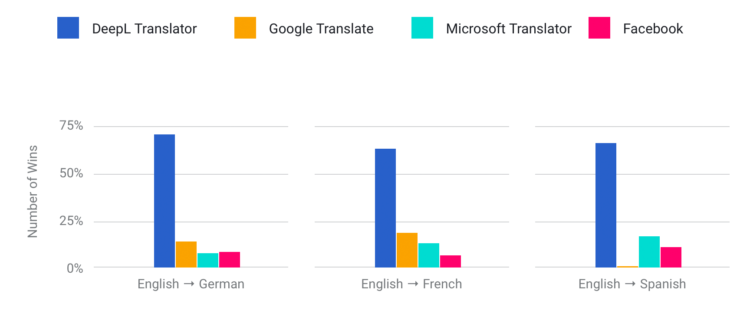
1
Use Case Machine Translation
DeepL Translator is a translation service launched in August 2017 by DeepL GmbH
Promising to deliver 3x better results compared to Microsoft Translator and Google Translate
www.yourwebsite.com

Slide 33
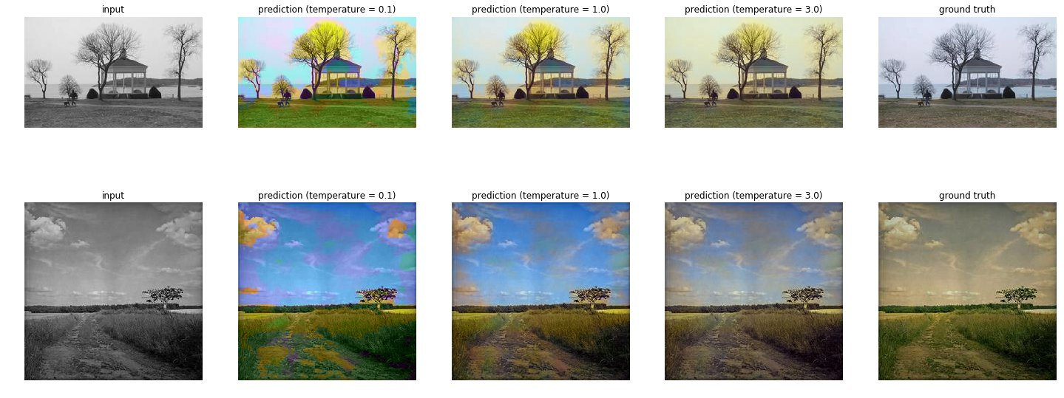
2
Usa Case Colorization Images
Paper : ColorUNet: A Convolutional Classiﬁcation Approach to Colorization
A final project of Computer Vision courses at Stanford University
Using Convolution Neural Network method classification to colorize grayscale images.
Research Center Digital Business Ecosystem

Slide 34
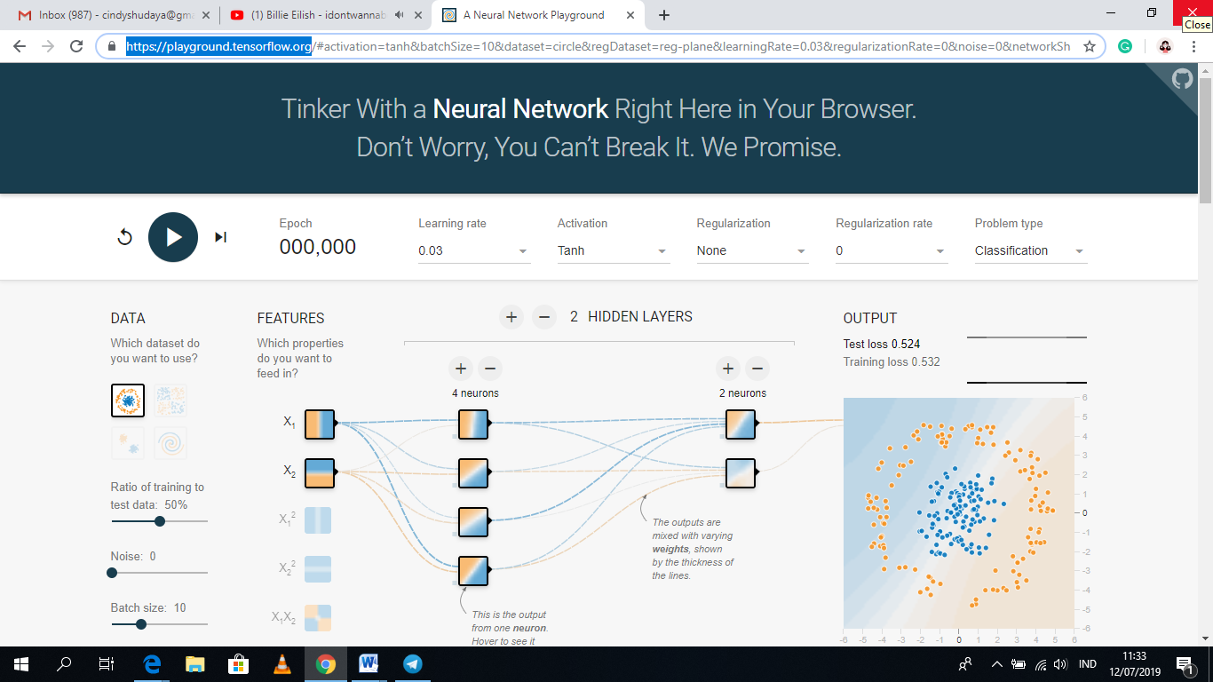
2
Tensorflow ANN
https://playground.tensorflow.org
Research Center Digital Business Ecosystem

